Slide 1
Chapter 7
How to prepare the data

Slide 2
Objectives
Applied
Add datetime, string, and numeric columns that are derived from other columns to a DataFrame.
Add summary columns to a DataFrame.
Apply functions, user-defined functions, and lambda expressions to a DataFrame.
Set an index, unstack the data based on an index, and reset the index.
Join, merge, and concatenate DataFrames.
Fix any problems that are identified by the SettingWithCopyWarning.

Slide 3
Objectives (continued)
Knowledge
Describe the appropriate uses for the join(), merge(), and concat() methods.
Describe an inner join.
Describe the SettingWithCopyWarning message and the type of problem that it may identify.

Slide 4
Some of the properties that are available from the dt accessor
year
month
day
quarter
days
seconds

Slide 5
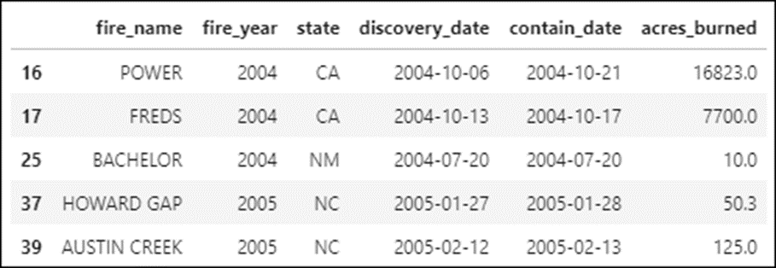
The fires DataFrame
fires.head()

Slide 6
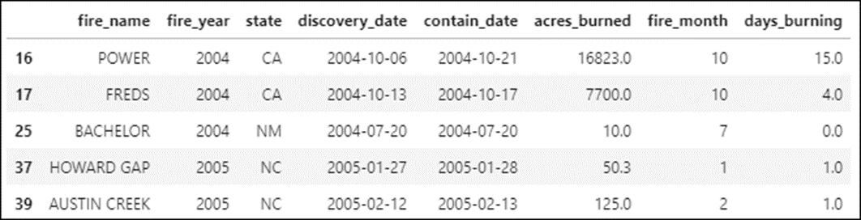
How to add a numeric column derived from a datetime column
fires['fire_month'] = fires.discovery_date.dt.month
How to add a numeric column derived from a datetime calculation
fires['days_burning'] = \
(fires.contain_date – fires.discovery_date).dt.days

Slide 7
Some of the methods that are available from the str accessor
count(str)
lower(str)
upper(str)
title(str)
lstrip(str)
rstrip(str)
strip(str)
startswith(str)
endswith(str)
find(str)
replace(old,new)
join(sequence)

Slide 8
How to modify a column derived from string data
fires['fire_name'] = fires.fire_name.str.title()
How to add a column derived from string data
fires['full_name'] = 'The ' + fires.fire_name + ' Fire ' \
+ '(' + fires.fire_year.astype(str) + ')'
How to add a column derived from numeric computations
fires['acres_per_day'] = \
fires.dropna().acres_burned / fires.dropna().days_burning

Slide 9
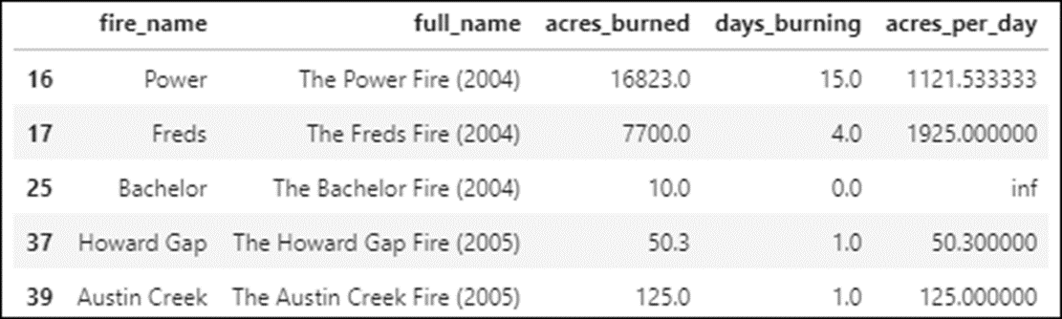
The new and modified columns
fires[['fire_name','full_name','acres_burned','days_burning',
'acres_per_day']].head()

Slide 10
The transform() method
Method | Description
transform(params) | Adds summary values to each row.
Parameters of the transform() method
Parameter | Description
func | The function to apply.
axis | 0 (the default) for rows; 1 for columns.

Slide 11
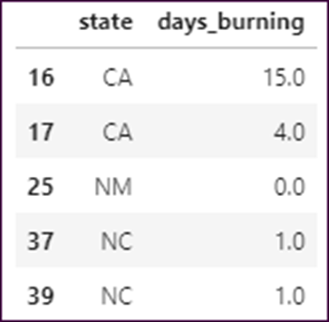
The fires data
fires[['state','days_burning']].head()

Slide 12
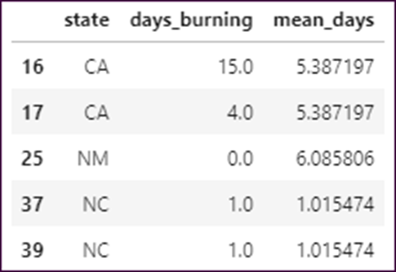
How to add a summary column to a DataFrame
fires['mean_days'] = fires.groupby('state')['days_burning']. \
transform(func='mean')
fires[['state','days_burning','mean_days']].head()

Slide 13
The apply() method
Method | Description
apply(params) | Applies a function to the data in a row or a column and returns a Series.
Parameters of the apply() method
Parameter | Description
function | The function that’s applied to each row or column. It can be a built-in function, a NumPy function, a user-defined function, or a lambda expression.
axis | The axis that the function is applied to: axis=0 (the default) for columns and axis=1 for rows.

Slide 14
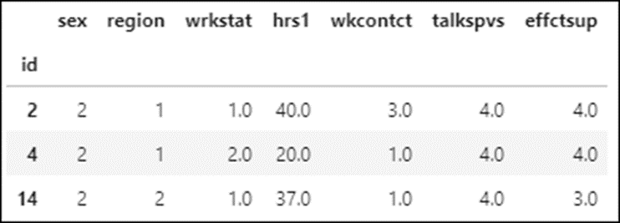
The workData DataFrame
workData.head(3)

Slide 15
How to apply a built-in Pandas function to all numeric columns
workData.apply('mean')
How to apply a NumPy function to two columns
import numpy as np
workData[['sex','hrs1']].apply(np.mean)
===============================================
sex 1.529897
hrs1 42.083505

Slide 16
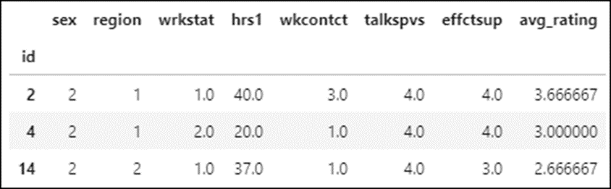
How to apply a function to row data
workData['avg_rating'] = workData[
['wkcontct','talkspvs','effctsup']].apply(np.mean, axis=1)
workData.head(3)

Slide 17
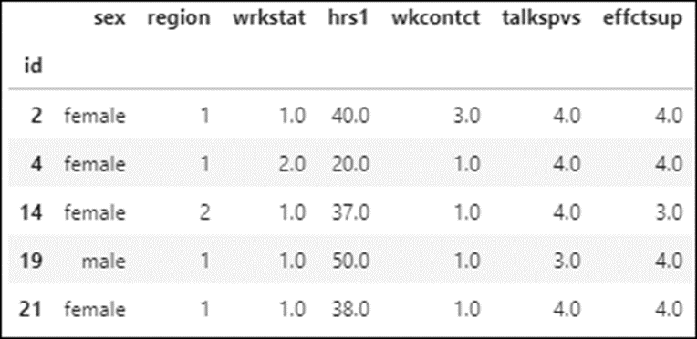
How to apply a user-defined function to a column
def convert_sex(row):
if row.sex == 1:
return 'male'
elif row.sex == 2:
return 'female'
else:
return 'non-binary'
workData['sex'] = workData.apply(convert_sex, axis=1)
workData.head()

Slide 18
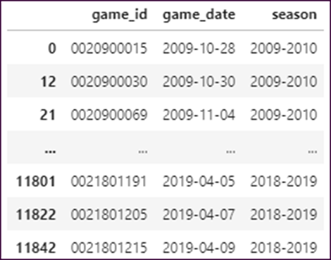
How to apply another user-defined function to a column
def get_season(row):
if row.game_date.month > 6:
season = f'{row.game_date.year}-{row.game_date.year + 1}'
else:
season = f'{row.game_date.year - 1}-{row.game_date.year}'
return season
gameData['season'] = gameData.apply(get_season, axis=1)
with pd.option_context('display.max_rows', 6,
'display.max_columns', None):
display(gameData)

Slide 19
The syntax of a lambda expression
The if syntax
lambda arguments: return-value-if-true if condition
The if-else syntax
lambda arguments: return-value-if-true if condition else
return_value-if-false
The if-elif-else syntax
lambda arguments: return_value-if-condition1-true if condition1 else
(return-value-if-condition-2-true if condition-2 else
return_value-if-condition-2-false)

Slide 20
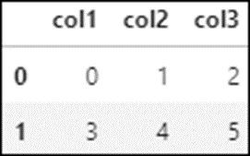
The example data
df
A lambda expression that sums and then doubles the value in each column
df.apply(lambda x: x.sum() * 2, axis=0)
=======================================
col1 6
col2 10
col3 14
dtype: int64

Slide 21
A lambda expression that sums and then doubles the value in each row
df.apply(lambda x: x.sum() * 2, axis=1)
=======================================
0 6
1 24
dtype: int64

Slide 22
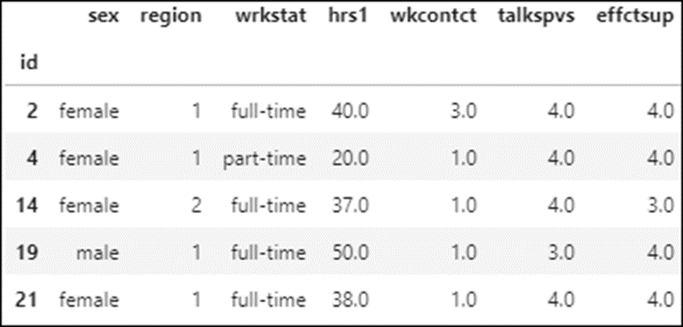
How to apply a lambda expression to a column
workData['wrkstat'] = workData.apply(
lambda row: 'full-time' if row.wrkstat == 1.0 else 'part-time',
axis=1)
workData.head()

Slide 23
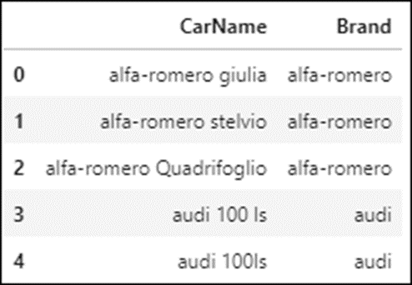
How to use a lambda expression to add a new column
carsData['Brand'] = carsData.apply(
lambda x: x.CarName.split()[0], axis=1)
carsData[['CarName','Brand']].head()

Slide 24
The set_index() method
Method | Description
set_index(params) | Sets an index for the specified column or list of columns.
Parameters of the set_index() method
Parameter | Description
keys | The column or list of columns to be used for the index.
inplace | If set to True, modifies the DataFrame in place.
verify_integrity | If set to True, throws an error if the specified index contains any duplicates.

Slide 25
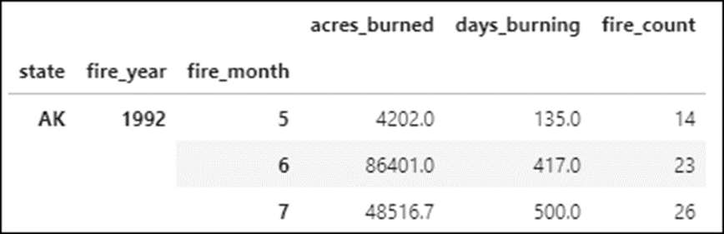
How to set an index
fires_by_month.set_index('state', inplace=True)
How to set an index on multiple columns
fires_by_month.set_index(['state','fire_year','fire_month'], inplace=True)
fires_by_month.head(3)

Slide 26
The reset_index() method
Method | Description
reset_index(params) | Resets the index to an auto-generated list of integers.
Parameters of the reset_index() method
Parameter | Description
inplace | If set to True, modifies the DataFrame in place.
level | The level of index to reset. By default, all indexes are reset.
drop | If set to True, drops the index columns instead of converting them to DataFrame columns.

Slide 27
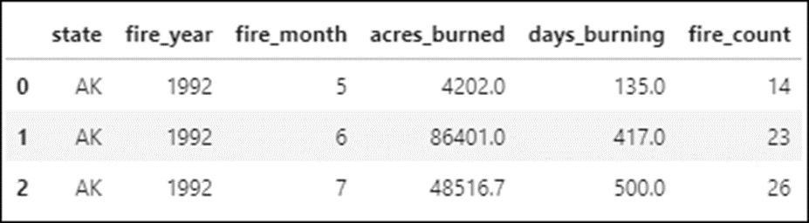
How to remove an index
fires_by_month.reset_index(inplace=True)
fires_by_month.head(3)

Slide 28
The unstack() method
Method | Description
unstack(params) | Unstacks the data in an indexed DataFrame.
Parameters of the unstack() method
Parameter | Description
level | The index column or list of index columns to unstack.
fill_value | A value that replaces any NA values.

Slide 29
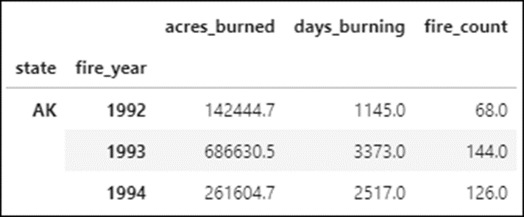
The top_states DataFrame in long form
top5_states.set_index(['state','fire_year'], inplace=True)
top5_states.head(3)

Slide 30
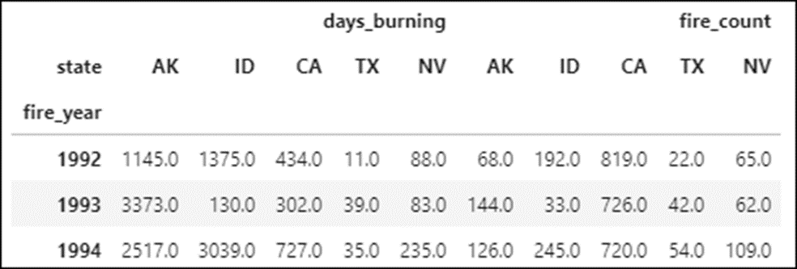
How to unstack two of the columns at the state level
top_wide = \
top5_states[['days_burning','fire_count']].unstack(level='state')
top_wide.head(3)

Slide 31
How to unstack all columns at the state level
top_wide = top5_states.unstack(level='state')
How to unstack a single column at the state level
top_wide = top5_states.fire_count.unstack(level='state')
How to use an integer to specify the state level
top_wide = top5_states[['days_burning','fire_count']].unstack(level=0')
How to unstack the rightmost index column
top_wide = top5_states.unstack()

Slide 32
The join() method
Method | Description
join(params) | Joins the columns in the left DataFrame with the columns in the right DataFrame based on an index.
Parameters of the join() method
Parameter | Description
df | The DataFrame or list of DataFrames to join with the calling DataFrame.
on | The column to be used for the index in the left DataFrame.
how | The type of join to use: left (the default), right, inner, or outer.
lsuffix | The suffix to append to any overlapping columns in the left DataFrame.
rsuffix | The suffix to append to any overlapping columns in the right DataFrame.

Slide 33
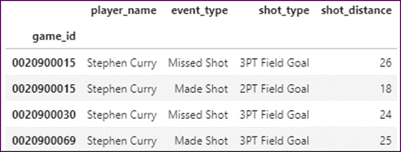
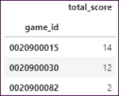
The shots DataFrame (just 4 rows)
The points_by_game DataFrame (just 3 rows)

Slide 34
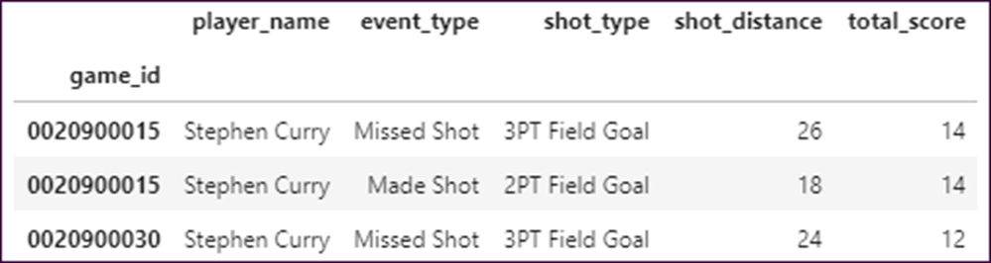
How to inner join the two DataFrames
shots_joined = shots.join(points_by_game, how='inner')
shots_joined

Slide 35
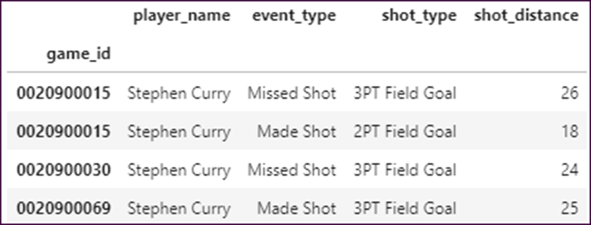
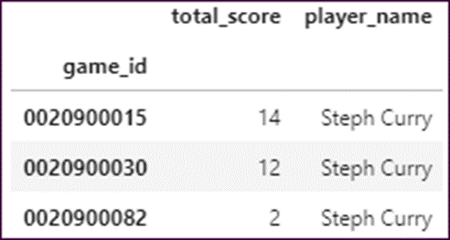
The shots DataFrame (just 4 rows)
The points_by_game DataFrame (just 3 rows)

Slide 36
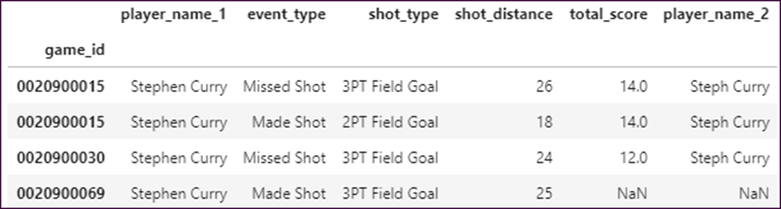
How to left join the two DataFrames
shots_joined = shots.join(points_by_game, lsuffix='_1',
rsuffix='_2', how='left')
shots_joined

Slide 37
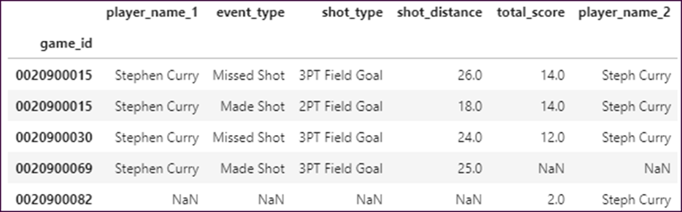
How to outer join the two DataFrames
shots_joined_outer = shots.join(points_by_game, lsuffix='_1',
rsuffix='_2', how='outer')
shots_joined_outer

Slide 38
The merge() method
Method | Description
merge(params) | Merges the columns in the left DataFrame with the columns in the right DataFrame based on the data in one or more columns that aren’t indexed.

Slide 39
Parameters of the merge() method
Parameter | Description
right | The DataFrame to merge with the current DataFrame.
on | The column or list of columns to merge on. By default, it uses the column names that are the same in both DataFrames.
how | Works like the join() method but uses ‘inner’ by default.
suffixes | A tuple that provides the values to append to columns with the same name in the left and right DataFrames.

Slide 40
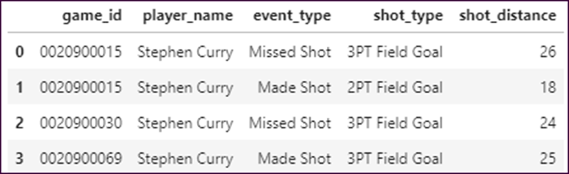
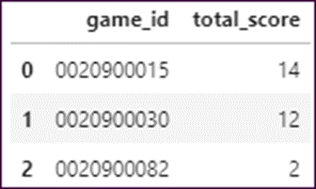
The shots DataFrame (just 4 rows)
The points_by_game DataFrame (just 3 rows)

Slide 41
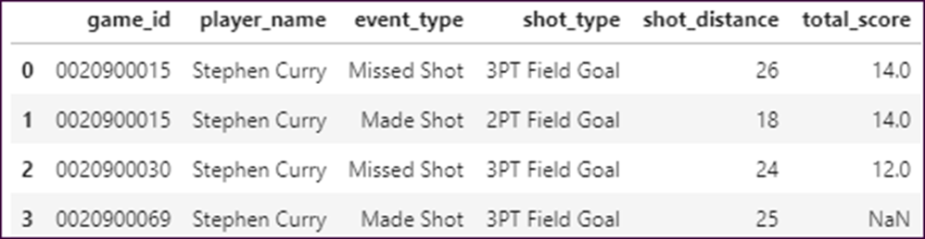
How to merge the two DataFrames
shots_merged = shots.merge(points_by_game, on='game_id',
how='left')
shots_merged

Slide 42
The concat() method
Method | Description
concat(params) | Concatenates (adds) the data in one DataFrame to another DataFrame.
Parameters of the concat() method
Parameter | Description
objs | A list of the DataFrames that you want to concatenate.
axis | The default of 0 adds rows to the bottom of the first DataFrame. Setting it to 1 adds columns to the right side of the first DataFrame.
ignore_index | If True, don’t keep the index values along the concatenation axis. Instead, reset the index on that axis.
join | If ‘inner’, use an inner join. Otherwise, use an outer join.

Slide 43
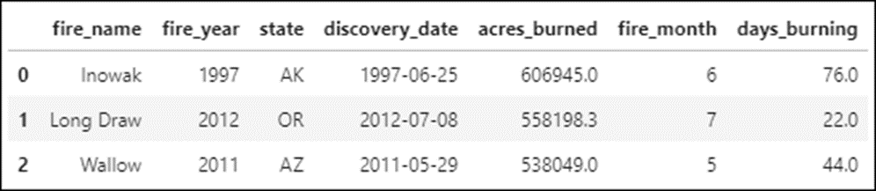
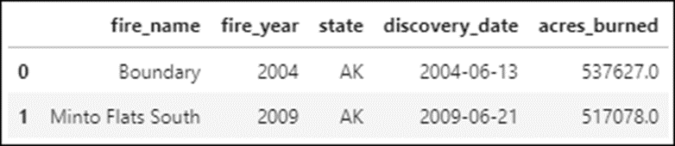
The fires_1 DataFrame (just 3 rows)
The fires_2 DataFrame (just 2 rows)

Slide 44
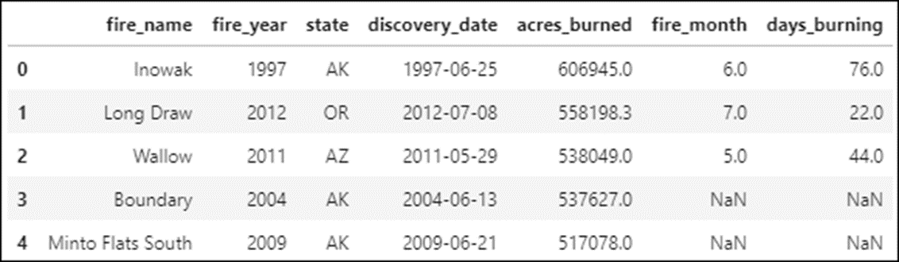
The concatenated DataFrame
fires_concat = pd.concat([fires_1,fires_2], ignore_index=True)
fires_concat

Slide 45
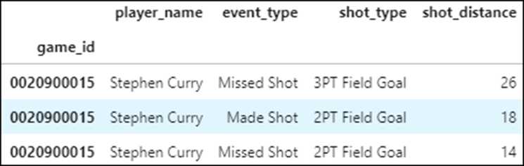
The SettingWithCopyWarning
df.head()
Code that generates the warning and corrupts the data
dfSlice = df.loc['0020900015',:] # creates the slice (view)
dfSlice.loc[:,'player_name'] = 'Curry' # modifies the slice
The warning
<ipython-input-93-57fca793a825>:1: SettingWithCopyWarning:
A value is trying to be set on a copy of a slice from a DataFrame.
Try using .loc[row_indexer,col_indexer] = value instead
See the caveats in the documentation: https://pandas.pydata.org/pandas-docs/stable/user_guide/indexing.html#returning-a-view-versus-a-copy
self[name] = value

Slide 46
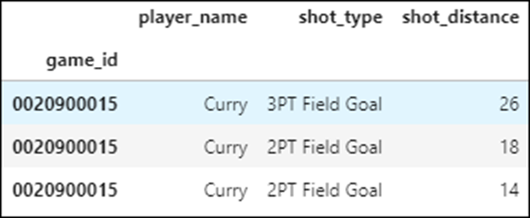
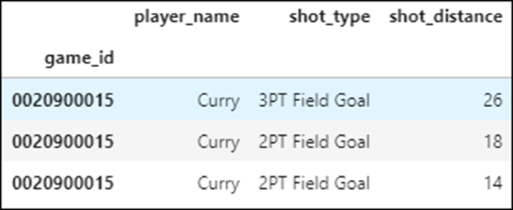
The SettingWithCopyWarning (continued)
The data after modification...but both DataFrames have been modified!
df.head(3)
dfSlice.head(3)

Slide 47
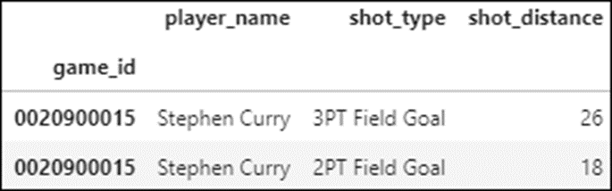
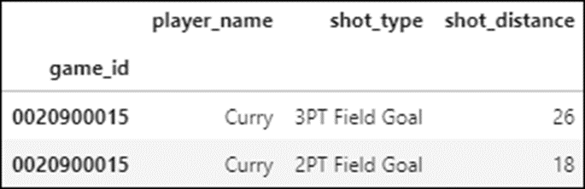
Code that generates the warning and doesn’t corrupt the data
dfSlice = df.query('game_id == "0020900015"')
dfSlice.loc[:,'player_name'] = 'Curry'
df.head(2)
dfSlice.head(2)

Slide 48
How to use the copy() method to stop the warning message
dfFixed = df.query('game_id == "0020900015"').copy()
dfFixed.loc[:,'player_name'] = 'Curry'

Slide 49

Code that generates the warning and does corrupt the data
dfSlice = df.loc['0020900015',:]
dfSlice.loc[:,'player_name'] = 'Curry'
df.head(2)
dfSlice.head(2)

Slide 50
How to use the copy() method to fix this code
dfFixed = df.loc['0020900015',:].copy()
dfFixed.loc[:,'player_name'] = 'Curry'

